Slide 1

Cloud Backups, Disaster Recovery, and Business Continuity

Slide 2
Preparing for disaster
High availability
Backup
Disaster recovery (DR)
Minimize how often your applications and data become unavailable
Make sure that your data is safe in case of disaster
Recover your data and get your applications back online after a disaster
Notes:
You can work to avoid and plan for disaster in three ways:
High availability provides redundancy and fault tolerance. A system is highly available when it can withstand failure of an individual or multiple components (for example, hard disks, servers, or network connectivity). Production systems typically have defined uptime requirements.
Backup is critical to protecting data and ensuring business continuity. However, it can be a challenge to implement. The pace at which data is generated is growing exponentially. Meanwhile, the density and durability of local disks are not experiencing the same growth rate. Even so, it is essential to keep your critical data backed up, in case of disaster.
Disaster recovery (DR) is about preparing for and recovering from a disaster. A disaster is any event that has a negative impact on a company’s business continuity or finances. Such events include hardware or software failure, a network outage, a power outage, or physical damage to a building (like fire or flooding). The cause can be human error, or some other significant event. Disaster recovery is a set of policies and procedures that enable the recovery or continuation of vital technology infrastructure and systems after any disaster.

Slide 3
Disaster Recovery
A disaster is a serious disruption occurring over a relatively short period of time, affecting the functioning of a community or a society as it causes widespread human, material, economic or environmental loss which exceeds the ability of the affected community or society to cope using its own resources
IT disaster means the unplanned interruption of normal business processes resulting from the interruption of the IT infrastructure components used to support them. This definition includes information systems and networks and their hardware and software components—as well as data itself.

Slide 4
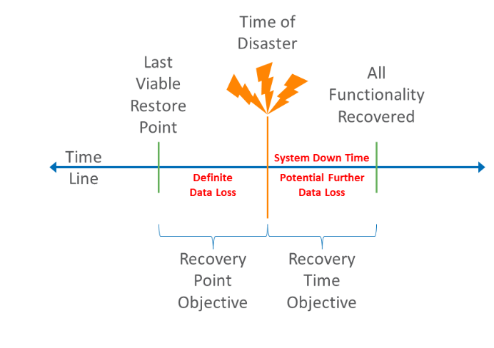
Disaster Recovery Plan: RPO and RTO
A DR plan is built around two key concepts, the RTO and RPO.
The RTO (Recovery Time Objective) states the maximum time limit that is acceptable for a certain process to be back and running. Here, a priority list will have to be set to determine in what order the processes need to be restored.
The RPO (Recovery Point Objective), it will report the maximum data loss the business can suffer, in minutes/hours, without having its services disrupted.

Slide 5
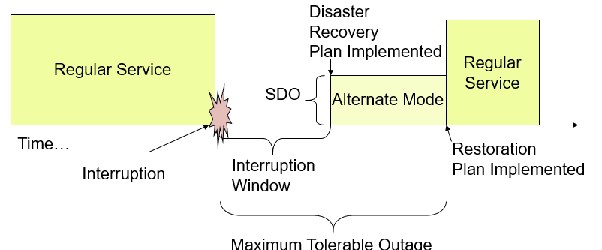
Disaster Recovery
Interruption Window: Time duration organization can wait between point of failure and service resumption
Service Delivery Objective (SDO): Level of service in Alternate Mode
Maximum Tolerable Outage: Max time in Alternate Mode
Disaster Recovery Plan (DRP): How to transition to Alternate Process Mode
Restoration Plan: How to return to regular system mode

Slide 6
Disaster Recovery
When using a DR Facilities provider there are many issues to consider.
There may be availability issues if the company has many customers in a single geographic area.
There may be phone and network bandwidth issues if more than one customer declares a disaster at a single time.
There may be lost of human capital
First ,Disaster Recovery Plan need to be created, then tested, and redefines and finally implemented and tested on a periodic basis.

Slide 7
Disaster Recovery Plan
Business Impact Analysis :A business impact analysis (BIA) predicts the consequences of disruption of a business function and process and gathers information needed to develop recovery strategies. Potential loss scenarios should be identified during a risk assessment.
Which business processes are of strategic importance?
What disasters could occur?
What impact would they have on the organization financially? Legally? On human life? On reputation?
What is the required recovery time period?
Answers obtained via questionnaire, interviews, or meeting with key users of IT

Slide 8
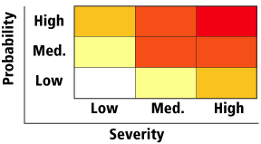
Risk Assessment
Severity ratings in this example represent:
High: major fracture, poisoning, significant loss of blood, serious head injury, or fatal disease
Medium: sprain, strain, localized burn, dermatitis, asthma, injury requiring days off work
Low: an injury that requires first aid only; short-term pain, irritation, or dizziness
Probability ratings in this example represent:
High: likely to be experienced once or twice a year by an individual
Medium: may be experienced once every five years by an individual
Low: may occur once during a working lifetime

Slide 9
Business Continuity
Business continuity is the advance planning and preparation undertaken to ensure that an organization will have the capability to operate its critical business functions during emergency events. Events can include natural disasters, a business crisis, pandemic, workplace violence, or any event that results in a disruption of your business operation. It is important to remember that you should plan and prepare not only for events that will stop functions completely, but for those that also have the potential to adversely impact services or functions
The following individuals are the core members of the BCM team. They are responsible for implementing the policies and directing BCM efforts across the organization.
Sponsor: The senior management individual with overall responsibility and accountability for the BCM program.
The Business Continuity Manager: The individual with direct responsibility for the BCM program.
Assistant Business Continuity Manager: The backup to the Business Continuity Manager. This could be a titled position or an assigned position.
Administrative Assistant: The individual responsible for supporting the BCM team. This is often an administrative assistant working in the Business Continuity office, if it exists, or another individual from the administrative assistant team.

Slide 10
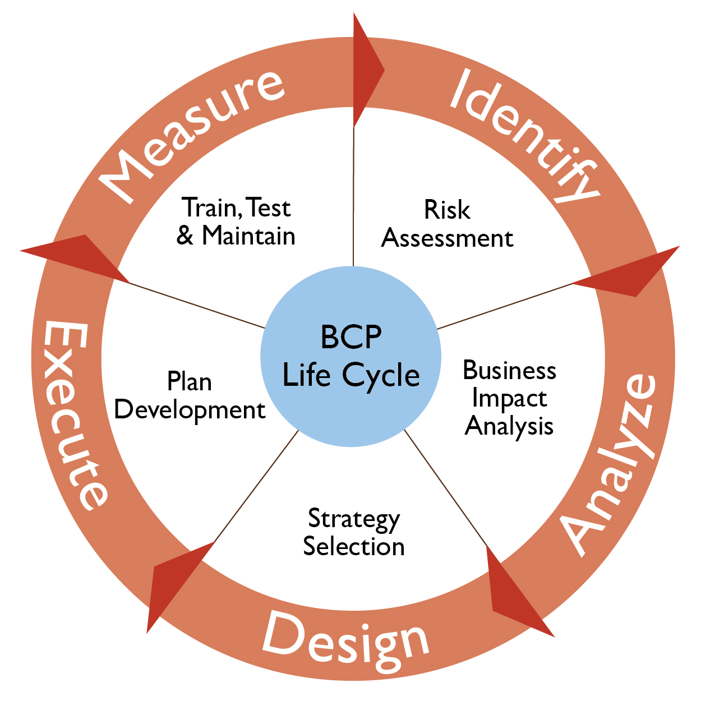
Business Continuity Life Cycle

Slide 11
Business Continuity Plan
Business Continuity Planning is a proactive planning process that ensures critical services or products are delivered during a disruption.
A Business Continuity Plan includes:
Plans, measures and arrangements to ensure the continuous delivery of critical services and products, which permits the organization to recover its facility, data and assets.
Identification of necessary resources to support business continuity, including personnel, information, equipment, financial allocations, legal counsel, infrastructure protection and accommodations.
A BCP typically includes five sections:
BCP Governance
Business Impact Analysis (BIA)
Plans, measures, and arrangements for business continuity
Readiness procedures
Quality assurance techniques (exercises, maintenance and auditing)

Slide 12
Business Continuity Plan: IT vs Business
Focus: | IT | Business
Event Recovery | Disaster Recovery Plan Procedures to recover at alternate site | Business Recovery Plan Recover business after a disaster
 | IT Contingency Plan: Recovers major application or system | Occupant Emergency Plan: Protect life and assets during physical threat
 | Cyber Incident Response Plan: Malicious cyber incident | Crisis Communication Plan: Provide status reports to public and personnel
Business Continuity |  | Business Continuity Plan
 |  | Continuity of Operations Plan Longer duration outages
Notes:
Here Event Recovery is how to react or recover from the incident.
Business Continuity is how Alternate Processing mode should operate.
12

Slide 13
DR vs BCP
Business Continuity Planning
A business continuity plan specifies how a company plans to restore core business operations when disasters occur
Disaster Recovery
Disaster recovery looks specifically at the technical aspects of how a company can get back into operation using backup facilities

Slide 14
Business Continuity Test Types
Checklist Review: Reviews coverage of plan – are all important concerns covered?
Structured Walkthrough: Reviews all aspects of plan, often walking through different scenarios
Simulation Test: Execute plan based upon a specific scenario, without alternate site
Parallel Test: Bring up alternate off-site facility, without bringing down regular site
Full-Interruption: Move processing from regular site to alternate site.
Notes:
Start with the simplest tests and proceed to the more complex tests.
From: All-in-One CISSP Exam Guide, 4th Edition, Shon Harris, McGraw Hill, 2008

Slide 15
Cloud Backups Sites
One of the most important aspects of disaster recovery is to have a location from which the recovery can take place. This location is known as a backup site. In the event of a disaster, a backup site is where your data center will be recreated, and where you will operate from, for the length of the disaster.
There are three different types of backup sites:
Cold backup sites
Everything required to restore service to your users must be procured and delivered to the site before the process of recovery can begin. As you can imagine, the delay going from a cold backup site to full operation can be substantial.
Cold backup sites are the least expensive sites.
Warm backup sites
A warm backup site is already stocked with hardware representing a reasonable facsimile of that found in your data center. To restore service, the last backups from your off-site storage facility must be delivered, and bare metal restoration completed, before the real work of recovery can begin.
Hot backup sites
Hot backup sites have a virtual mirror image of your current data center, with all systems configured and waiting only for the last backups of your user data from your off-site storage facility. As you can imagine, a hot backup site can often be brought up to full production in no more than a few hours.
A hot backup site is the most expensive approach to disaster recovery.

Slide 16
Cloud Backups (1/4)
A Cloud backup is where a remote, online, or managed service provides users with a system for backing up, storing, and recovering data files.
File Backups: The original type of backup was a file backup, which is still a popular method. A file backup copies all the files and folders from the current data to backup media and cloud.
Image Backups :An image backup bypasses most of the OS file-lookup overhead by simply copying blocks to backup in order to the end, making a complete record of everything on the disk. This process results in extremely fast backups.
16
Notes:
16

Slide 17
Cloud Backups (2/4)
Setting the RPO : The RPO determines how often recovery points must be created. If the RPO is 30 minutes, a recovery point must be established every 30 minutes. The backup window defines how much time is available for the backup process.
A backup plan is the record of what data is to be backed up on what schedule.
Fallow the backup plan :
Full: The first backup of a system, capturing everything in it. The upside of a full backup is that it’s self-contained. The downside is that it takes up a lot of space, can take a long time to complete, and can be almost identical to a previous full backup.
Differential: A backup that captures only the differences between the current state and the last full backup. Recovering from a differential backup requires both the last full backup and the differential backup to be valid. The upside of a differential backup is that it’s much faster than a full backup. The downside is that it takes up more space than an incremental backup (see the next paragraph) and requires at least two backup files to be read for recovery.
Incremental: A backup that captures only the differences between the current state and the last differential, incremental, or full backup.
Both image backups and file backups can be full, differential, or incremental.
17
Notes:
17

Slide 18
Cloud Backups (3/4)
Cloud Backup programs may access data on your system in two ways:
With an agent: A small backup program called an agent is installed on every physical and virtual machine (VM).
Without an agent: In cloud and virtual environments, the number of VMs can grow quite large, so agentless backup comes into play.
Bare-metal restore is a system with absolutely no software installed in it. Because file backups, unlike image backups, don’t have all the system metadata and bootstrapping, they can’t restore to bare metal. One major benefit of an image backup is that it provides both the ability to recover files to a running system and a complete restore to bare metal even when the backup wasn’t made on an identical system.
File backup can only recover files to a running system, but image backup is able to both recover individual files to a running system and recover everything to bare metal.
18
Notes:
18

Slide 19
Cloud Backups (4/4)
Compression : the process of making files smaller by using various algorithms to substitute abbreviations for repeated information. It is useful for local copies of backups, and most storage specs that you see assume compression. Compression works when the data contains a lot of predictability
Deduplication (also called dedupe) is similar to compression. If you back up 1,000 system images of standard corporate laptops, for example, you find the same OS files over and over. High amounts of duplication require a lot of space that can be saved through the use of deduplication. Dedupe works by keeping one copy of the original data and inserting pointers into each set of backup data that contains the duplicate data.
19
Notes:
19

Slide 20
Backup vs. Fault-Tolerant (FT) Storage
People sometimes confuse backup with fault-tolerant storage.
A backup is a separate copy of a file, written to a different device. It should be able to survive even when the primary fails. Some storage, such as RAID devices, looks like backup at first blush, but they are really better described as fault-tolerant storage.
Fault-tolerant storage has some internal protections against failure, but it does not provide enough protection to be considered a backup.
A drive spanning device such as a RAID 5 can preserve the data in the event a single drive malfunctions, but the device itself is still a single unit, and has nearly all the vulnerabilities that a single copy of the data has.
Don't confuse fault-tolerance with true backup.

Slide 21
Questions ?

Slide 22












Storage and backup building blocks
AWS Cloud
Block
File
Object
Data storage
Amazon EBS
EC2 instance store
Amazon EFS
Amazon FSx for Windows File Server
Amazon S3
Amazon S3 Glacier
Data transfer
Corporate data center
AWS Direct Connect
AWS DataSync
AWS Storage Gateway
AWS Snowball
Notes:
The following services are referenced in the diagram:
Amazon Elastic Block Store (Amazon EBS)
Amazon Elastic Compute Cloud (Amazon EC2)
Amazon Elastic File System (Amazon EFS)
Amazon Simple Storage Service (Amazon S3)
Amazon Simple Storage Service Glacier (Amazon S3 Glacier)
To start your disaster planning in detail, look at the data storage layer (postponing the discussion of database layer for the moment).
Your AWS Cloud storage can consists of a combination of block storage, file system storage, and object storage. Meanwhile, your organization might also use AWS services that connect the on-premises data center to the AWS Cloud.
In the next few slides, you will learn about high-level best practices for each of these three areas.
One service that you might not be familiar with is AWS DataSync. AWS DataSync provides movement of large amounts of data online between on-premises storage and Amazon S3, Amazon EFS, or Amazon FSx for Windows File Server. It supports scripted copy jobs and scheduled data transfers from on-premises Network File Systems (NFS) and Server Message Block (SMB) storage. It can also optionally use AWS Direct Connect links.

Slide 23


Best practice: S3 Cross-Region Replication
AWS Cloud
Block
File
Object
Amazon EBS
EC2 instance
store
Amazon EFS
Amazon FSx for Windows File Server
Amazon S3
Amazon S3 Glacier
Most S3 storage classes replicate data across Availability Zones within a single Region
Configure S3 Cross-Region Replication for higher-level data security
Automatically, asynchronously replicates objects created after you add the replication configuration
Can also help meet compliance requirements and reduce latency for users who are accessing objects
Region A
Region B
Source
S3 bucket
(replication configured)
Destination
S3 bucket
Notes:
For many organizations, the bulk of their data that is stored on AWS is in Amazon S3, which provides object storage.
Recall that S3 buckets exist in a specific AWS Region. You choose the Region when you create the bucket. Amazon S3 provides 11 9s (99.999999999 percent) of durability for S3 Standard, S3 Standard-IA, S3 One Zone-IA, and Amazon S3 Glacier storage classes. Amazon S3 Standard, S3 Standard-IA, and Amazon S3 Glacier are all designed to sustain data if an entire Amazon S3 Availability Zone loss occurs. They provide this stability by automatically storing your objects across a minimum of three Availability Zones, each separated miles apart, across a single AWS Region.
For critical applications and data scenarios where you want a higher level of data security, it is a best practice to configure S3 Cross-Region Replication. To enable the replication, you add a replication configuration to your source bucket. The minimum configuration must indicate the destination bucket where you want Amazon S3 to replicate all objects, or a subset of all objects. It must also include an AWS Identity and Access Management (IAM) role that grants Amazon S3 permissions to copy the objects to the destination bucket.
Copied objects retain their metadata. The destination bucket can belong to another storage class. For example, the contents of an S3 Standard bucket might be replicated to an Amazon S3 Glacier bucket. You can assign different ownership to the objects in the destination bucket. You can also use S3 Replication Time Control (S3 RTC) to replicate your data across different Regions in a predictable time frame. S3 RTC replicates four 9s (99.99 percent) of new objects stored in Amazon S3 within 15 minutes (backed by a service-level agreement).

Slide 24

Best practice: EBS volume snapshots
AWS Cloud
Block
File
Object
Amazon EBS
EC2 instance
store
Amazon EFS
Amazon FSx for Windows File Server
Amazon S3
Amazon S3 Glacier
Create point-in-time snapshots of EBS volumes
Snapshots provide incremental backups (they back up the blocks that changed since the previous snapshot)
Snapshots enable you to restore data to a new EBS volume
Use Amazon Data Lifecycle Manager to automate the creation, retention, and deletion of snapshots
You cannot snapshot instance storage
Region A
Region B
Source
EBS volume
Snapshot stored in Amazon S3
Copy of snapshot
Notes:
Regarding to block storage, you can back up the data that is on EBS volumes to Amazon S3 by taking point-in-time snapshots. Snapshots are incremental backups, which means that it saves only the blocks on the device that have changed since your most recent snapshot. This architecture minimizes the time that is required to create the snapshot, and it saves on storage costs by not duplicating data.
Each snapshot contains all the information that is needed to restore your data (from the moment when the snapshot was taken) to a new EBS volume. When you create an EBS volume that is based on a snapshot, the new volume begins as an exact replica of the original volume. This original volume was used to create the snapshot. The replicated volume loads data in the background so that you can begin to use it immediately. If you access data that has not been loaded yet, the volume immediately downloads the requested data from Amazon S3. Then, it continues to load the rest of the volume's data in the background.
Amazon EBS volumes provide off-instance storage that persists independently from the life of an instance, and is replicated across multiple servers in an Availability Zone. Volumes prevent the loss of data from the failure of any single component. After you create a snapshot, it finishes copying to Amazon S3 (when the snapshot status is completed). Then, you can copy it from one AWS Region to another, or within the same Region.
You can use Amazon Data Lifecycle Manager to automate the creation, retention, and deletion of snapshots that back up your EBS volumes. Automating snapshot management helps you to:
Protect valuable data by enforcing a regular backup schedule
Retain backups as required by auditors or internal compliance
Reduce storage costs by deleting outdated backups
You cannot create snapshots of EC2 instance store volumes. However, if you must back up data from an instance store, you can create a new EBS volume and format it. Then, mount the new volume to the EC2 instance guest OS and copy the data on your instance store volume to the EBS volume. Recall that instance store volumes provide temporary block-level storage that works well for information that changes frequently, such as buffers, caches, and scratch data. You might find that you must back up data from an instance store. If so, you might want to rethink why you are storing that data on an instance store volume in the first place.

Slide 25


Best practice: File system replication
AWS Cloud
Block
File
Object
Amazon EBS
EC2 instance
store
Amazon EFS
Amazon FSx for Windows File Server
Amazon S3
Amazon S3 Glacier
Replicate EFS or FSx for Windows File Server file systems across Regions
Replicate on-premises file systems to the cloud
Region A
Region B
On-premises
Source
file system
AWS DataSync
Destination EFS or FSx
file system
AWS DataSync
AWS Direct Connect (optional)
Source
file system
Notes:
It is also a best practice to replicate your file storage.
AWS DataSync makes data move faster between two EFS or Amazon FSx Windows File Server file systems, or between on-premises storage and AWS file storage. You can use DataSync to transfer datasets over DX or the internet. Use the service for one-time data migrations or ongoing workflows for data protection and recovery.
You can learn more about how to use AWS Backup to manage EBS volume backups and to automate backups of EFS file systems. See the Scheduling automated backups using Amazon EFS and AWS Backup blog for details.
FSx for Windows File Server takes daily automatic backups of your file systems, and it enables you to take more backups at any point. Amazon FSx stores the backups in Amazon S3. The daily backup window is a 30-minute window that you specify when you create a file system. The daily backup retention period that is specified for your file system determines the number of days that your daily automatic backups are kept. (This number is 7 days by default.)
Like most Amazon S3 storage classes replicate data across Availability Zones, so do Amazon EFS and FSx for Windows File Server file systems. Your disaster recovery requirements might specify that you need a multi-region recovery solution. In that case, it is a best practice to replicate your Amazon EFS and FSx for Windows File Server file systems to a second Region. You can use AWS DataSync to get this replication. To simplify file transfer between two EFS file systems by using DataSync, you can use the AWS DataSync In-Cloud QuickStart and Scheduler.

Slide 26









Compute capacity should be quickly recoverable
Obtain and boot new server instances or containers within minutes.
Amazon EC2
Amazon Elastic Container Service (Amazon ECS)
Custom Amazon Machine Images (AMIs)
Custom container images
EC2 Auto Scaling group
ECS cluster running containers
Notes:
In the context of DR, it’s critical that you can rapidly create virtual machines that you control. By launching instances in separate Availability Zones, you can protect your applications from the failure of a single location.
You can arrange for automatic recovery of an EC2 instance when a system status check of the underlying hardware fails. The instance is rebooted (on new hardware, if necessary)—but it retains its instance ID, IP addresses, EBS volume attachments, and other configuration details. For a complete recovery, make sure that the instance is configured to automatically start up any services or applications as part of its initialization process.
Amazon Machine Images (AMIs) are preconfigured with operating systems, and some preconfigured AMIs might also include application stacks. You can also configure your own custom AMIs. In the context of DR, AWS recommends that you configure and identify your own AMIs so that they launch as part of your recovery procedure. Such AMIs should be preconfigured with your operating system of choice, in addition to the appropriate pieces of the application stack.

Slide 27
Strategies for compute disaster recovery
Use the Amazon EC2 snapshot capability for backups
Snapshots can be performed manually, or scheduled (for example, by using AWS Lambda)
Use system or instance level system backups infrequently and as a last resort
Drives up the cost of storage that is used quickly
Prefer automated rebuild from configuration or code repositories instead
Cross-region AMI copies
Cross-region snapshot copies
Consider transient compute architectures
Store essential data off of the instance
Transient compute example
Long-lived resources
AMI
S3 buckets
4
1
Pull data
Create instance
2
Write data
Process data
5
Created Instance
3
Terminated instance
Time
Notes:
For disaster recovery of compute resources, you will probably want to use the Amazon EC2 snapshot capability. Snapshots can be performed manually, or they can be scheduled.
Although you can create system or instance-level system backups, extensive use of this approach increases your storage costs. A better approach is to configure an automated rebuild process, where your source code is stored in a repository.
You might want to replicate Amazon S3 across Regions, and you probably also want to replicate your most critical AMIs and snapshots across Regions.
Finally, consider architecting your use of compute resources to store essential data off of the instances. As you see in the example, your data can be stored in an S3 bucket. When you must do data processing, you can launch one or more EC2 instances from a custom AMI that is preconfigured with application software. As soon as the instance is started, it can pull the needed data from the S3 bucket and process the data. Then, it can write the output data back to Amazon S3 (perhaps to another S3 bucket). After the instance completes its compute tasks, the instance can be terminated. Such an architecture—when it can still meet your business needs—makes it easier to design your disaster recovery strategy. It also can save on costs, because servers that are not in constant use can be terminated and then later re-created when needed.

Slide 28



Networking: Design for resilience, recovery
Amazon Route 53
Elastic Load Balancing
Traffic distribution
Failover
Load balancing
Health checks and failover
Amazon Virtual Private Cloud (Amazon VPC)
AWS Direct Connect
Extend your existing on-premises network topology to the cloud
Fast, consistent replication and backups of large on-premises environments to the cloud
Notes:
When you work to recover from a disaster, it’s likely that you must modify network settings to fail your system over to another site. AWS offers several services and features that enable you to manage and modify network settings, a few of which are highlighted next.
Amazon Route 53 provides load balancing and network routing capabilities that enable you to distribute network traffic. It also provides the ability to fail over between multiple endpoints and even to a static website that is hosted in Amazon S3.
The Elastic Load Balancing service automatically distributes incoming application traffic across multiple EC2 instances. It enables you to achieve fault tolerance in your applications by providing the load-balancing capacity that is needed in response to incoming application traffic. You can pre-allocate a load balancer so that its Domain Name System (DNS) name is already known, which can simplify execution of your DR plan.
You can use Amazon Virtual Private Cloud (Amazon VPC) to extend an existing on-premises network topology to the cloud. This extension can be especially appropriate when you recover enterprise applications that might be hosted on an internal network.
Finally, AWS Direct Connect simplifies the setup of a dedicated network connection from an on-premises data center to AWS. Using DX can reduce network costs, increase bandwidth throughput, and provide a more consistent network experience than internet-based connections.

Slide 29


Databases: Features that support recovery
Amazon Relational Database Service (Amazon RDS)
Amazon DynamoDB
Take snapshot data and save it in a separate Region
Combine read replicas with Multi-AZ deployments to build a resilient disaster recovery strategy
Retain automated backups
Back up entire tables in seconds
Use point-in-time-recovery to continuously back up tables for up to 35 days
Initiate backups with a single click in the console or a single application programming interface (API) call
Use Global Tables to build a multi-region, multi-master database that provides fast local performance for massively scaled globally distributed applications
Notes:
AWS provides many database services. Some key features of Amazon RDS and Amazon DynamoDB that are relevant to disaster recovery scenarios are explained next.
Consider using Amazon RDS in the DR preparation phase to store a copy of your critical data in a database that is already running. Then, use Amazon RDS in the DR recovery phase to run your production database.
If you implement a multi-region DR plan, Amazon RDS gives you the ability to store snapshot data that was captured from one Region to another Region. You can share a manual snapshot with up to 20 other AWS accounts.
Combining read replicas with Multi-AZ deployments enables you to build a resilient disaster recovery strategy and simplify your database engine upgrade process. By using Amazon RDS read replicas, you can create one or more read-only copies of your database instance. You can create these copies within the same AWS Region, or in a different AWS Region. Updates to the source database are then asynchronously copied to your read replicas. Read replicas can be promoted to become a standalone database instance, when needed.
Use Amazon DynamoDB in the preparation phase to copy data to DynamoDB in another Region or to Amazon S3. During the recovery phase of DR, you can scale up in minutes. DynamoDB global tables replicate your DynamoDB tables automatically across your choice of AWS Regions. They resolve update conflicts and enable your applications to stay highly available, even in the unlikely event that an entire Region is isolated or affected by degradation.

Slide 30



Automation services: Quickly replicate or redeploy environments
AWS CloudFormation
Use templates to quickly deploy collections of resources as needed
Duplicate production environments in new Region or VPC in minutes
AWS Elastic Beanstalk
Quickly redeploy your entire stack in only a few clicks
AWS OpsWorks
Automatic host replacement
Combine it with AWS CloudFormation in the recovery phase
Provision a new stack that supports the defined RTO
Notes:
When you use automation services, you can quickly replicate or redeploy environments.
AWS CloudFormation enables you to model and deploy your entire infrastructure in a text file. This template can become the single source of truth for your infrastructure. When you use AWS CloudFormation to manage your entire infrastructure, it also becomes a powerful tool in your disaster recovery planning toolkit. It enables you to duplicate complex production environments in minutes, for example, to a new Region or a new VPC.
AWS CloudFormation provisions your resources in a repeatable manner, which enables you to build and rebuild your infrastructure and applications. You are not required to perform manual actions or write custom scripts.
If you use AWS Elastic Beanstalk to host your applications, you can upload an updated application source bundle and deploy it to your AWS Elastic Beanstalk environment. Alternatively, you can redeploy a previously uploaded version of an application. You can also deploy a previously uploaded version of your application to any of its environments.
Finally, AWS OpsWorks is an application management service that makes it easy to deploy and operate applications of all types and sizes. You can define your environment as a series of layers, and configure each layer as a tier of your application. AWS OpsWorks has automatic host replacement, so if you have an instance failure, it is automatically replaced. You can use AWS OpsWorks in the DR preparation phase to template your environment and combine it with AWS CloudFormation in the DR recovery phase.

Slide 31
Common disaster recovery patterns on AWS
Four disaster recovery patterns
Backup and restore
Pilot light
Warm standby
Multi-site
Each pattern is suited to a different combination of:
Recovery point objective
Recovery time objective
Cost-effectiveness

Slide 32




Backup and restore pattern
Back up configuration and state data to S3. Implement lifecycle policy to save on cost.
Corporate data center
AWS Cloud
Lifecycle policy
S3 bucket
Amazon S3 Standard-IA
Amazon S3 Glacier
AWS Cloud
Restore when needed.
Corporate data center
Lifecycle policy
S3 bucket
Amazon S3 Standard-IA
Amazon S3 Glacier
Endpoint
VPC in DR Region
Amazon EC2
Notes:
The first disaster recovery approach is the backup and restore pattern.
In most traditional environments, data is backed up to tape and sent offsite regularly. If you use this method, it can take a long time to restore your system when a disaster occurs.
Amazon S3 provides a more easily accessible destination for backup data that might be needed quickly to perform a restore. Transferring data to and from Amazon S3 is typically done through the network, and is therefore accessible from any location.
In the example backup scenario, data is copied from the on-premises data center to Amazon S3. AWS DataSync or Amazon S3 Transfer Acceleration can optionally be used as part of this configuration to automate or increase the speed of data transfer. Then, an S3 lifecycle configuration that is applied to the bucket later moves the backup data to less-expensive Amazon S3 storage classes. The backup data moves to Amazon S3 Glacier or Amazon S3 Standard-IA, which saves on cost as the data ages and is not frequently accessed.
In the example restore scenario, the on-premises data might be temporarily or permanently lost. Then, the backup data can be downloaded from Amazon S3 back to the on-premises servers.
If your corporate data center remains offline, you can further ensure the ability to restore your data to your servers. You can have Amazon EC2 servers that are ready to go in a VPC in your designated disaster recovery Region. This Region can connect to the S3 bucket that contains your backup application data. It can read that data, and perhaps temporarily host your applications while you work to restore your data center.

Slide 33




AWS Storage Gateway
On-premises infrastructure
Archive
HTTPS
NFS or SMB
File
gateway
Amazon S3 Standard
S3 Glacier vault
iSCSI
S3 bucket
HTTPS
Option to restore to volume, attach
Volume
gateway
AWS Storage Gateway
Server
VTL – iSCSI
Stored as EBS snapshots
EC2 instance
S3 bucket
HTTPS
Archive
Tape
gateway
Stored as virtual tape libraries
S3 Glacier vault
Notes:
As part of the backup and restore pattern, you might find that it makes sense to use AWS Storage Gateway.
AWS Storage Gateway is a hybrid storage service that enables your on-premises applications to use AWS Cloud storage. You can use the service for backup and archiving, disaster recovery, cloud data processing, storage tiering, and migration.
Your applications connect to the service through a virtual machine or hardware gateway appliance by using standard storage protocols. These protocols include NFS, SMB, Virtual Tape Library (VTL), and Internet Small Computer System Interface (iSCSI). The gateway connects to AWS storage services—such as Amazon S3, Amazon S3 Glacier, and Amazon EBS—which provide storage for files, volumes, and virtual tapes. The service includes an optimized data transfer mechanism. It provides bandwidth management, automated network resilience, and efficient data transfer, in addition to a local cache for low-latency on-premises access to your most active data.
With a file gateway, you store and retrieve objects (by using the NFS or SMB protocol) in Amazon S3. You use a local cache for low-latency access to your most recently used data. When your files are transferred to Amazon S3, they are stored as objects and can be accessed through an NFS mount point.
The Storage Gateway volume interface presents your applications with block storage disk volumes that can be accessed by using the iSCSI protocol. Data on these volumes is backed up as point-in-time EBS snapshots, which enables you to access it through Amazon EC2, if needed.
The Storage Gateway tape interface presents the Storage Gateway to your existing backup application as a virtual tape library. This library consists of a virtual media changer and virtual tape drives. You can continue to use your existing backup applications while you write to a collection of virtual tapes. Each virtual tape is stored in Amazon S3. When you no longer require access to data on virtual tapes, your backup application archives it from the virtual tape library into Amazon S3 Glacier.

Slide 34
Backup and restore: Checklist
Preparation phase
Create backups of current systems
Store backups in Amazon S3
Document procedure to restore from backups
Know:
Which AMI to use, and build as needed
How to restore system from backups
How to route traffic to the new system
How to configure the deployment
In case of disaster
Retrieve backups from Amazon S3
Restore required infrastructure
EC2 instances from prepared AMIs
Elastic Load Balancing load balancers
AWS resources created by an AWS CloudFormation stack – automated deployment to restore or duplicate the environment
Restore system from backup
Route traffic to the new system
Adjust Domain Name System (DNS) records accordingly

Slide 35


Pilot light pattern: Preparation phase
On-premises or AWS Cloud
AWS Cloud
www.example.com
Web
server
Web
server
Web server
Servers exist, but are not running
Route 53
hosted zone
Web
server
App
server
App server
Data mirroring and replication
Primary DB
Secondary DB
Notes:
The second disaster recovery approach is the pilot light pattern.
Pilot light describes a disaster recovery pattern where a minimal backup version of your environment is always running. The pilot light analogy comes from a gas heater: a small flame (or the pilot light) is always on, even when the heater is off. The pilot light can quickly ignite the entire furnace to heat a house. In the example pattern, the pilot light is the secondary database that is always running.
The pilot light scenario is similar to the backup-and-restore scenario. However, recovery time is typically faster because the core pieces of the system are already running and are continually kept up-to-date. When the time comes for recovery, you can rapidly provision a full production environment around the critical core.
Infrastructure elements for the pilot light itself typically include your database servers. This grouping is the critical core of the system (the pilot light). All other infrastructure pieces can quickly be provisioned around it to restore the complete system. To provision the rest of the infrastructure, you typically bundle preconfigured servers as AMIs that are ready to be started at a moment’s notice. (Or they might be instances that are in a stopped state.) When recovery begins, these instances start quickly with their pre-defined role, which enables them to connect to the database.
This pattern is relatively inexpensive to implement. Regularly changing data must be replicated to the pilot light, the small core around which the full environment starts in the recovery phase. Your less frequently updated data, such as operating systems and applications, can be periodically updated and stored as AMIs.

Slide 36
Pilot light pattern: In case of disaster
On-premises or AWS Cloud
AWS Cloud
www.example.com
Web
server
Web server
Servers start in minutes
Route 53
hosted zone
Web
server
App
server
App server
Data mirroring and replication
Primary DB
Secondary DB
Notes:
Suppose that disaster strikes, and your primary application goes offline. In this case, you can quickly commission the compute resources to run the application or to orchestrate the failover to pilot light resources in AWS. In this example, the secondary database stores critical data. If there is a disaster, the new web server and app server start up and connect to the secondary database. Amazon Route 53 is configured to then route traffic to the new web server.
The primary environment can exist in an on-premises data center, or in another Region or Availability Zone on AWS. Either way, you can use the pilot light pattern to meet your recovery time objective (RTO).

Slide 37
Pilot Light Pattern: Checklist
Preparation phase
Configure EC2 instances to replicate or mirror servers
Ensure that all supporting custom software packages are available on AWS
Create and maintain AMIs of key servers where fast recovery is needed
Regularly run these servers, test them, and apply any software updates and configuration changes
Consider automating the provisioning of AWS resources
In case of disaster
Automatically bring up resources around the replicated core dataset
Scale the system as needed to handle current production traffic
Switch over to the new system
Adjust DNS records to point to AWS
Notes:
If you implement the pilot light disaster recovery pattern, the key steps that you should complete during the preparation phase are:
Configure the EC2 instances
Ensure that all of the supporting custom software packages are available
Create and maintain essential AMIs where fast recovery is required
Regularly run and test servers, and apply software updates and configuration updates
Consider automating the provisioning of AWS resources
If you implement the pilot light pattern, the key steps to complete in case of disaster are:
Automatically bring up resources around the replicated core dataset
Scale the system as needed to handle current production traffic
Switch over to the new system by adjusting the DNS records to point to the backup deployment

Slide 38

Warm standby pattern: Preparation phase
On-premises or AWS Cloud
User or system access
AWS Cloud
Auto Scaling
group
Web
server
Web
server
Active
Web
server
Route 53
hosted zone
Web server
Low capacity
Web
server
App
server
App
server
App server
Auto Scaling group
Data mirroring and replication
Primary DB
Secondary DB
Notes:
The third disaster recovery approach is the warm standby pattern.
The warm standby pattern is like the pilot light, but more resources are already running. The term warm standby describes a disaster recovery scenario where a scaled-down version of a fully functional environment is always running in the cloud. The warm standby solution extends the pilot light elements and preparation. It further decreases the recovery time because some services are always running. By identifying your business-critical systems, you can fully duplicate these systems and have them always on.
These servers can be running on a minimum-sized fleet of EC2 instances with the smallest sizes possible. This solution is not yet scaled to take a full production load, but it is fully functional. Though it exists for DR purposes, you can also use it for non-production work, such as testing, quality assurance, and internal use.
In the example, two systems are running. The main system might be running in an on-premises data center or an AWS Region, and a low-capacity system is running on AWS. Use Amazon Route 53 to distribute requests between the main system and the backup system.

Slide 39
Warm standby pattern: In case of disaster
On-premises or AWS Cloud
User or system access
AWS Cloud
Auto Scaling
group
Web
server
Web
server
Active
Web
server
Web servers
Low capacity at switchover, starts to scale up
Route 53
hosted zone
Web
server
App
server
App
server
App servers
Auto Scaling group
Data mirroring and replication
Primary DB
Secondary DB
Notes:
In a disaster, if the primary environment is unavailable, Amazon Route 53 switches over to the secondary system.
The secondary system can then quickly begin to scale up to handle the production load. You can produce this increase by adding more EC2 instances to the load balancer. Alternatively, you can resize the small capacity servers to run on larger EC2 instance types. Horizontal scaling (creating more EC2 instances) is preferred over vertical scaling (increasing the size of existing instances).

Slide 40
Warm standby pattern: Checklist
Preparation
Similar to pilot light
All necessary components running 24/7, but not scaled for production traffic
Best practice: Continuous testing
Trickle a statistical subset of production traffic to the DR site
In case of disaster
Immediately fail over most critical production load
Adjust DNS records to point to AWS
(Automatically) Scale the system further to handle all production load
Notes:
If you implement the warm standby disaster recovery pattern, the preparation phase is important. The key steps that you should complete during the preparation phase are similar to the steps that you complete for the pilot light pattern. The most notable difference is that all the necessary components should be left running 24/7, but not scaled for production traffic.
As a best practice, conduct continuous testing. You might also trickle a statistical subset of production traffic to the DR site. Thus, you can verify that it functions for users and systems as seamlessly as the primary system.
With the warm standby pattern, in case of disaster, the key steps to complete are:
Immediately fail over the most critical production load
Adjust DNS records to point to AWS
(Automatically) Scale the system further to handle all production load

Slide 41
Multi-site pattern
On-premises or AWS Cloud
AWS Cloud
User or system
Web
server
Web
server
Web
server
Web
server
Route 53
hosted zone
Web servers
Full capacity always running
Web
server
App
server
App
server
App servers
Data mirroring and replication
Primary DB
Secondary DB
Notes:
The fourth and final disaster recovery approach is the multi-site pattern. With this pattern, you have a fully functional system that runs in a second Region of AWS. It runs at the same time as the on-premises systems or the systems that run in a different AWS Region.
A multi-site solution runs in an active-active configuration. The data replication method that you employ is determined from the recovery point that you choose.
Because both sites can support the full production capacity, you might choose to use a DNS service that supports weighted routing. An example is Amazon Route 53, which routes production traffic to both sites that deliver the same application or service. In this scenario, a proportion of traffic goes to your infrastructure in AWS, and the remainder goes to your on-site infrastructure. (Or if the two environments exist in separate AWS Regions, the traffic is proportioned between these two Regions.)
In an on-site or primary AWS Region disaster situation, you can adjust the DNS weighting and send all the traffic to the second deployment. The capacity of the secondary deployment can then be rapidly increased to handle the full production load as needed. You can use Amazon EC2 Auto Scaling to automate this process. You might need some application logic to detect the failure of the primary database services and cut over to the parallel already-running database services.
The cost of this scenario is determined from the volume of production traffic during normal operation. In the recovery phase, you pay for only what you use for the duration that the DR environment is needed at full scale. You can further reduce cost by purchasing Amazon EC2 Reserved Instances for your always-on AWS servers.

Slide 42
Multi-site pattern
On-premises or AWS Cloud
AWS Cloud
User or system
Web
server
Web
server
Web
server
Web
server
Route 53
hosted zone
Web servers
Full capacity always running
Web
server
App
server
App
server
App servers
Data mirroring and replication
Primary DB
Secondary DB
Notes:
The fourth and final disaster recovery approach is the multi-site pattern. With this pattern, you have a fully functional system that runs in a second Region of AWS. It runs at the same time as the on-premises systems or the systems that run in a different AWS Region.
A multi-site solution runs in an active-active configuration. The data replication method that you employ is determined from the recovery point that you choose.
Because both sites can support the full production capacity, you might choose to use a DNS service that supports weighted routing. An example is Amazon Route 53, which routes production traffic to both sites that deliver the same application or service. In this scenario, a proportion of traffic goes to your infrastructure in AWS, and the remainder goes to your on-site infrastructure. (Or if the two environments exist in separate AWS Regions, the traffic is proportioned between these two Regions.)
In an on-site or primary AWS Region disaster situation, you can adjust the DNS weighting and send all the traffic to the second deployment. The capacity of the secondary deployment can then be rapidly increased to handle the full production load as needed. You can use Amazon EC2 Auto Scaling to automate this process. You might need some application logic to detect the failure of the primary database services and cut over to the parallel already-running database services.
The cost of this scenario is determined from the volume of production traffic during normal operation. In the recovery phase, you pay for only what you use for the duration that the DR environment is needed at full scale. You can further reduce cost by purchasing Amazon EC2 Reserved Instances for your always-on AWS servers.

Slide 43
Multi-site : Checklist
Preparation
Similar to warm standby
Configured for full scaling in or scaling out for production load
In case of disaster
Immediately fail over all production load
Notes:
If you are implementing the multi-site disaster recovery pattern, the key steps to complete during the preparation phase are similar to the warm standby pattern. You must configure the backup deployment for full scaling in and out of the production load. You should have the servers running and ready to receive traffic.
With the multi-site pattern, in case of disaster, you only need to complete one key step. That step is to immediately fail over all of the production load to the backup site.
The multi-site pattern potentially has the least downtime of all. However, it does have more costs that are associated with it, because more systems are running.

Slide 44
Summary of common DR patterns
more
RTO
Cost
less
Backup and restore
Pilot light
Warm standby
Multi-site
Lower-priority use cases
Solutions: Amazon S3, Storage Gateway
Meeting lower RTO and RPO requirements
Core services
Scale AWS resources in response to a DR event
Solutions that require RTO and RPO in minutes
Business-critical services
Automatic failover of your environment in AWS to a running duplicate
Notes:
To summarize, each of the four DR patterns offers a different combination of benefits.
The diagram shows a spectrum for the four scenarios, arranged by how quickly a system can be available to users after a DR event.
The backup and restore pattern typically can be accomplished at the lowest cost, but it has a longer RTO. As a result, your systems are likely to be restored more slowly than with the other options.
The warm standby and multi-site patterns support a much faster RTO, but it is costly to have extra servers that are always running.
AWS enables you to cost-effectively operate each of these DR strategies. It’s important to realize that these patterns are only examples of possible approaches, and variations and combinations of these patterns are possible. If your application runs on AWS, then you can use multiple Regions, and the same DR strategies still apply.

Slide 45



DR preparation: Best practices
Start simple
Check for software licensing issues
Practice Game Day
exercises
Notes:
Creating a comprehensive disaster recovery plan can be a complex undertaking. However, most organizations recognize—perhaps from past events—that it is worth the effort.
Even though it takes time to develop and implement a full plan, it should not stop you from taking some simple first steps. Start simple, and work your way up. For example, as a first step, create backups of data storage, databases, and critical servers. Then, work to incrementally improve RTO and RPO as a continuous effort.
Software licensing is an issue that can surface while you create backup sites. Look into the software licensing that you have to determine whether your current license contracts support your DR plans. Upgrade your licenses or adjust in other ways as necessary.
Finally, it is a best practice to consistently exercise your DR solution so you can ensure that it works as intended. Some suggested steps include:
Practice Game Day exercises. These exercises test scenarios when critical systems go offline—or even entire regions. What if an entire fleet crashes?
Ensure that backups, snapshots, and AMIs are being created, and that they can be used to successfully restore data.
Monitor your monitoring system.
Test your response procedures to ensure they are effective and that teams are familiar with their execution. Set up regular Game Days to test workload and team responses to simulated events.

Slide 46
Questions ?

